Slide 1


SAP
IMPLEMENTATION
By
Sustainable Outreach And Universal
Leadership Limited (SOUL)

Slide 2
CONTENTS
ABOUT SOUL LIMITED
INTRODUCTION OF SOUL
KIIT - THE LEADER IN EDUCATION
KIIT - SOUL ASSOCIATION
SAP MODULES LIST

Slide 3









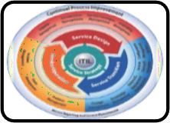


ABOUT SOUL LIMITED
SOUL Limited is the sister concern of KIIT’s which executes Strategy Consulting for Business transformation focused on sustainability through operational efficiency and capital productivity; using delivery process realignment, skill restructuring, smart negotiation, and contracting.
Our Insights:
Smart campus solutions using IoT and AI.
Skilled human resources for operation and maintenance of solar appliances
Deployment of Enterprise Applications for
governance of University.
Sustainable engagement in core strategy,
operational and technical development.
Design and deployment of education aids.
IT infrastructures support to organizations as per ITIL standards.
Sustainable Healthcare, Modernizing Agriculture, Skill development in manufacturing, Disability Cluster.
Robotics-Aiding institutions with humanoids for contactless services.

Slide 4








INTRODUCTION OF SOUL
CERTIFICATION
MSME certified micro industry with UDYAM Registration No.-
UDYAM-OD-19-008646
Energy & Smart Infrastructure
Education
ISO Certified – ISO 9001:2015, ISO/IEC 20000-1:2018, ISO/IEC 27001:2013 & ISO 14001:2015
Meaningful and sustainable solutions
Skill
Development
IT & ITES
EMPANELMENT
Broadcast Engineers Consultants India Limited
Health and Social Wellness
Agriculture
Bharat Sanchar Nigam Limited
Rural Development
Partnership

Slide 5









KIIT - THE LEADER IN EDUCATION
90+
Projects
India’s first QS 5 Stars Rated University
No 1 among the private higher education Indian Universities
1921+
Publications
21st in India Rankings by NIRF
2500
Researchers
SOUL will leverage skillsets and research outcomes to build world class products and services for its distinguished clients
30K
Students

Slide 6

KIIT - SOUL ASSOCIATION
SOUL as the associate consultant of KIIT
SOUL is authored with the rights to use the financial and experiential credentials of KIIT
KIIT and SOUL
share financial gains for the executed projects
KIIT=SOUL
SOUL can deploy the faculties, research scholars
, ground staff of KIIT as its own resource

Slide 7
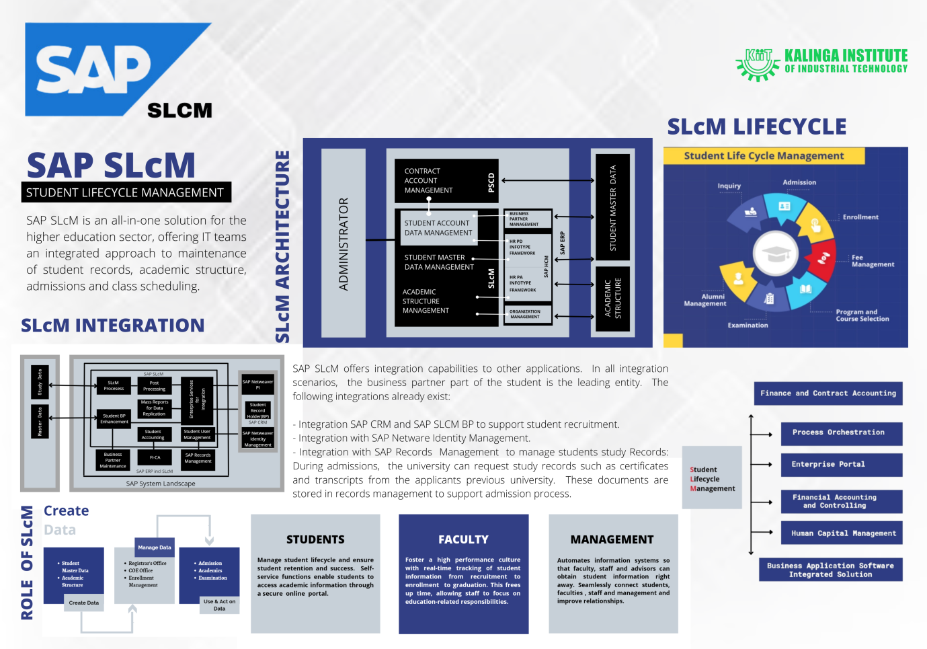
STUDENT LIFECYCLE MANAGEMENT (SLCM)
SLCM is a holistic and
data-informed approach
that focuses on the entire
student journey, from
Admission through Alumni
to ensure student success.
Some of the important features in SLCM would be :
Admission
Academics
Examination
DE-Registration
Class Scheduling
Attendance

Slide 8
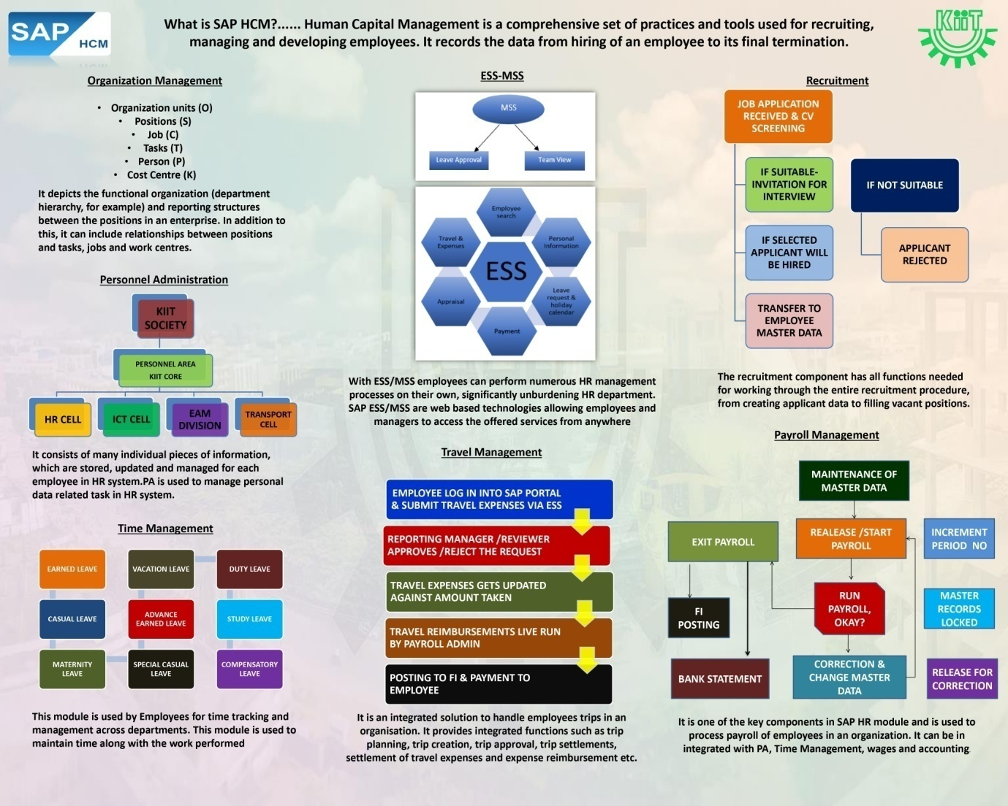
HUMAN CAPITAL MANAGEMENT (HCM)
HCM solutions provide strategic, innovative solutions for core HR and payroll, time and attendance, talent management, employee experience management, and people analytic to address the critical workforce transformation needs.
Examples :
Maintaining Employee Personnel Data
Administrative processes
Work Hours
Leave Data
Recruitment
Applicant Interview
Assessment of Employee Training

Slide 9
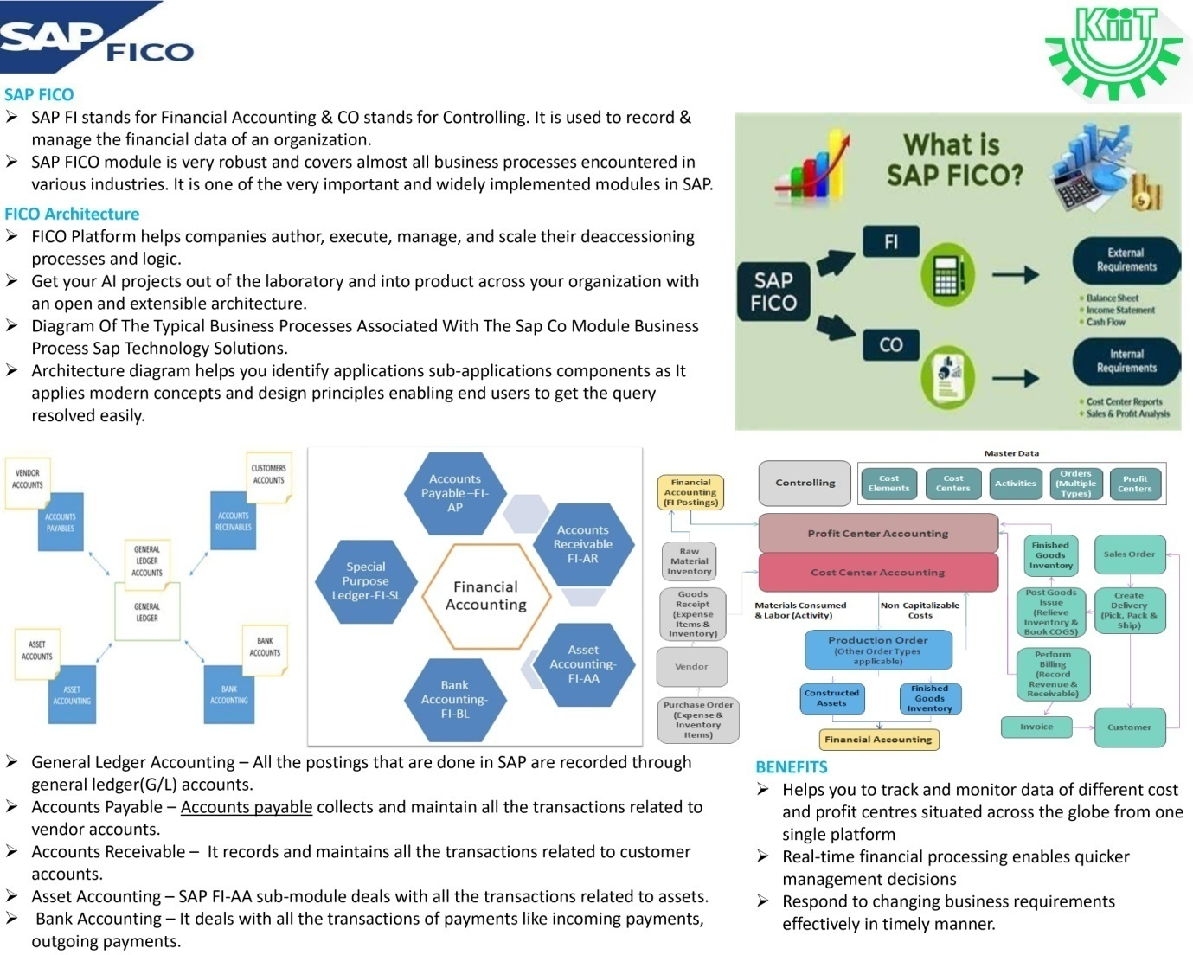
FINANCE & CONTROLLING (FICO)
FICO is an important core functional component that allows KIIT to manage all of its financial data.
Example :
Balance Sheet Preparation
Bank Reconciliation
P&L Statement

Slide 10
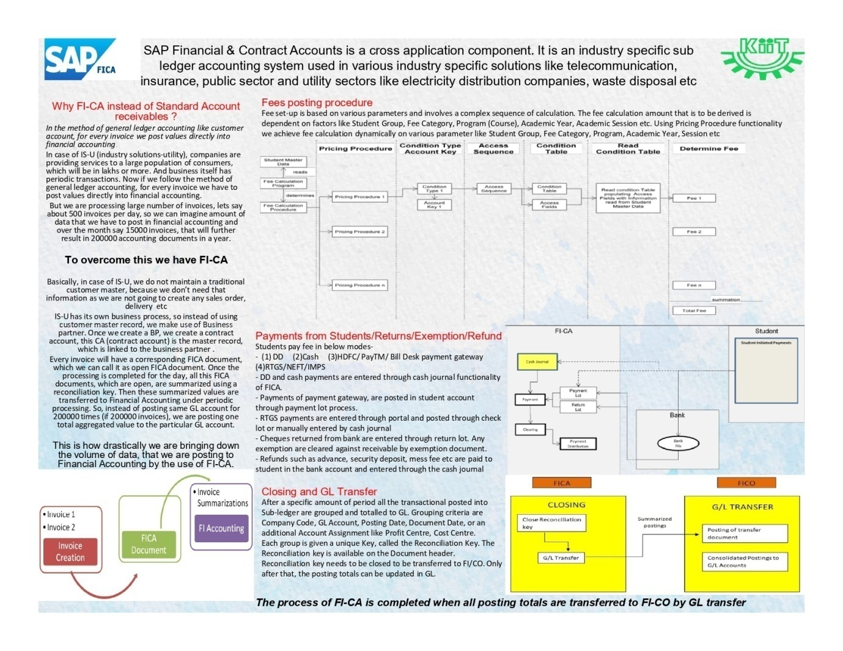
FINANCIAL CONTRACTS AND ACCOUNTS (FICA)
FICA component allows KIIT to manage all of its financial contracts and Contract Accounts Receivable and Payable.
Example :
Fee Posting
Fee Adjustments
Payment received from Students
Resolving issues of Accounts Department / End Users

Slide 11
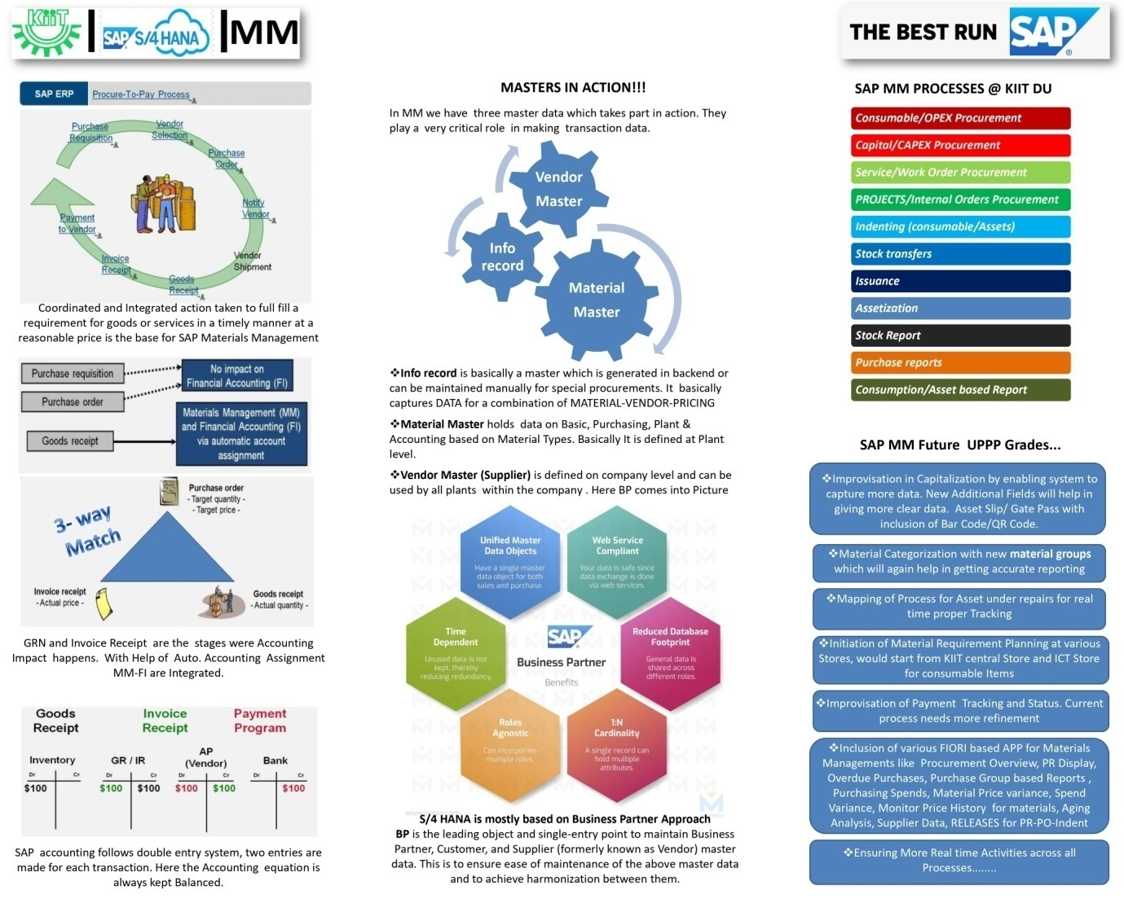
MATERIAL MANAGEMENT (MM)
MM plays a vital role in KIIT. It provides us with materials, inventory and warehouse management capabilities.
Example :
Procurement of Capital / Consumable Items
Stock Inventory
Purchase Requisition
Purchase Orders
Order Management

Slide 12
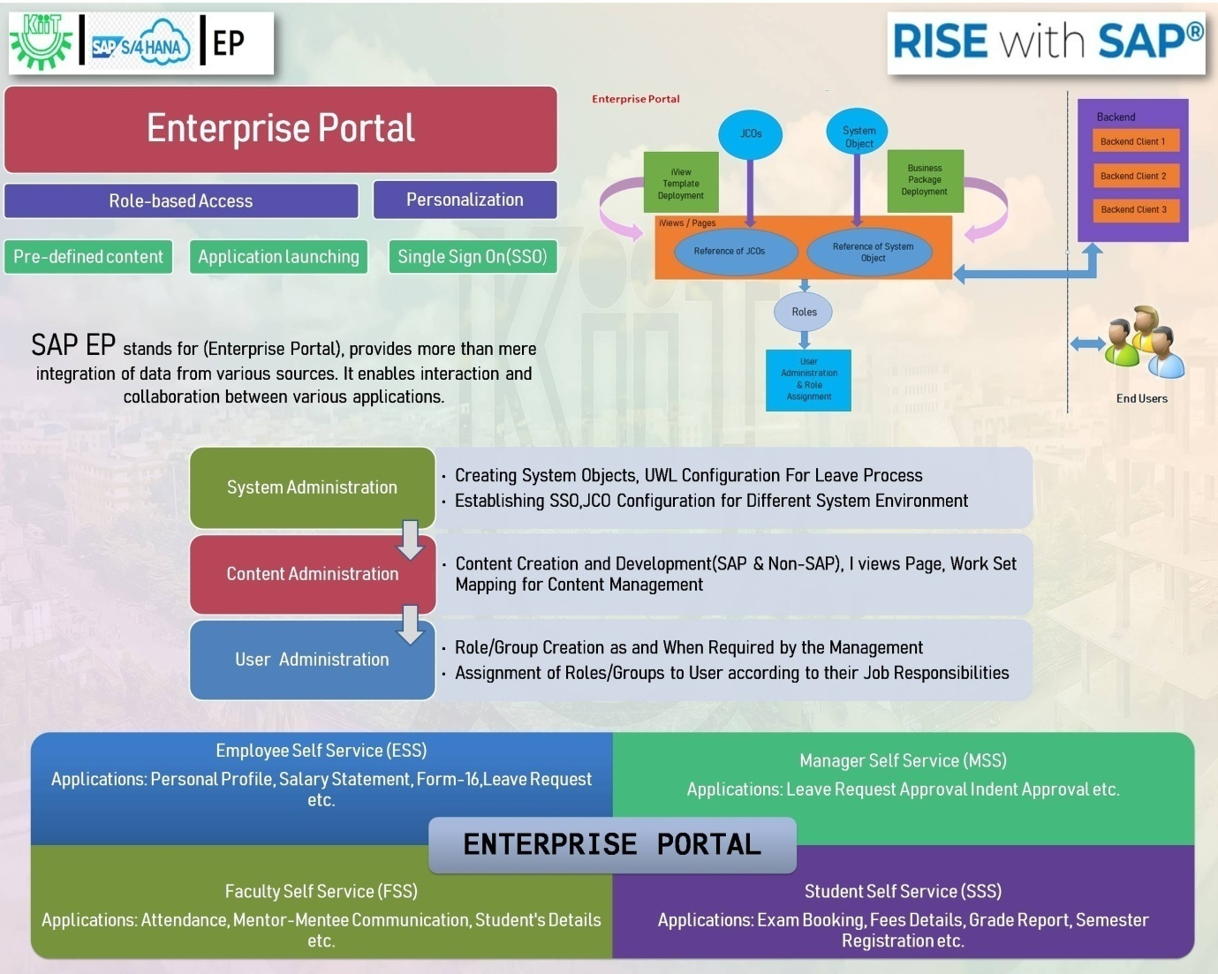
ENTERPRISE PORTAL (EP)
EP is a web front-end component for SAP Net Weaver - the comprehensive integration and application platform that facilitates the alignment of people, information, and business processes across organizational and technical boundaries.
Example :
It acts as a Front End / User Interface for the end users such as Employee , Faculty, Student, Manager) to access the application.

Slide 13
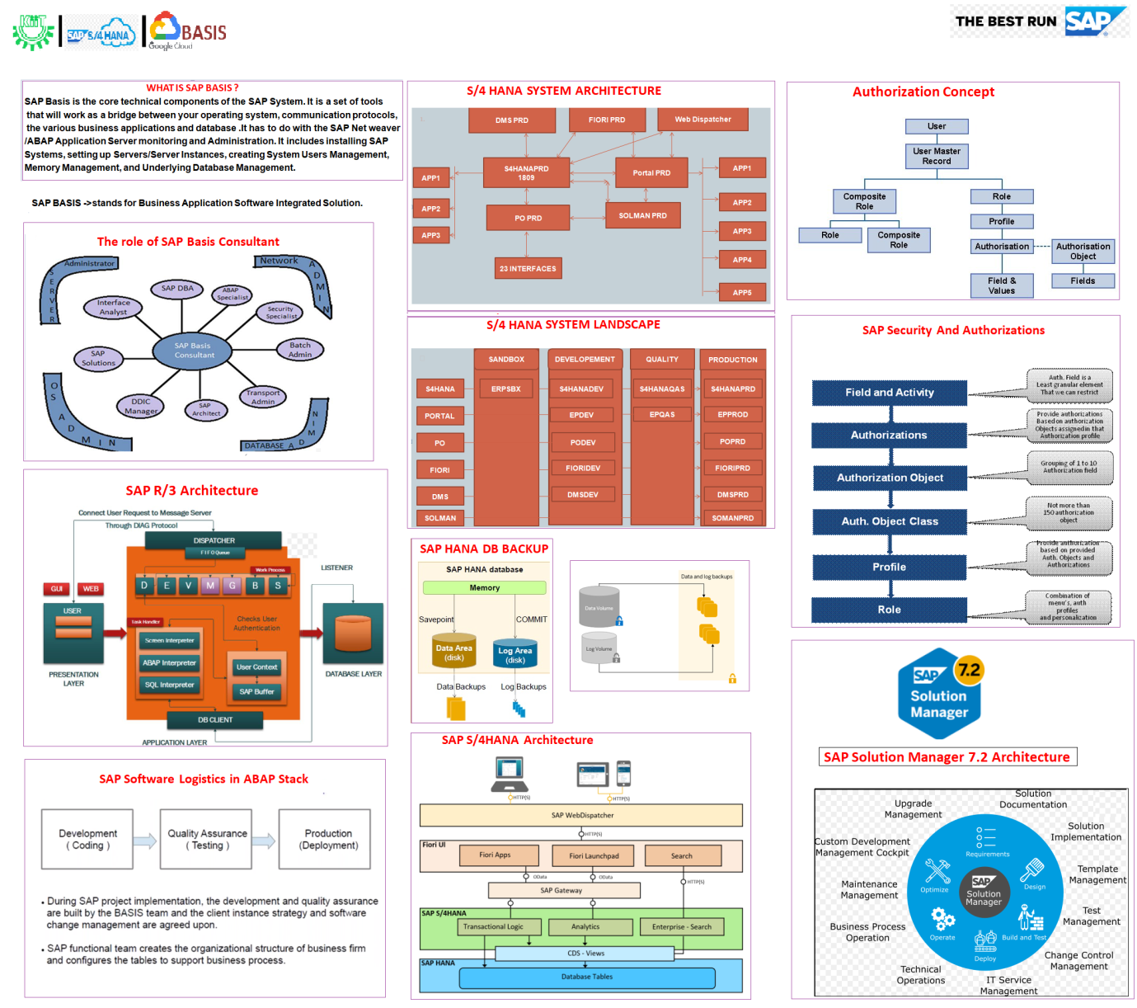
BUSINESS APPLICATION SOFTWARE INTEGRATED SOLUTION (BASIS)
BASIS is a set of middleware programs and tools that provide the underlying base that enable applications to be interoperable across operating systems. SAP Basis includes a RDBMS, GUI, and client server architecture.
Example:
Installation / Maintenance / Upgrade / Monitoring of SAP System

Slide 14
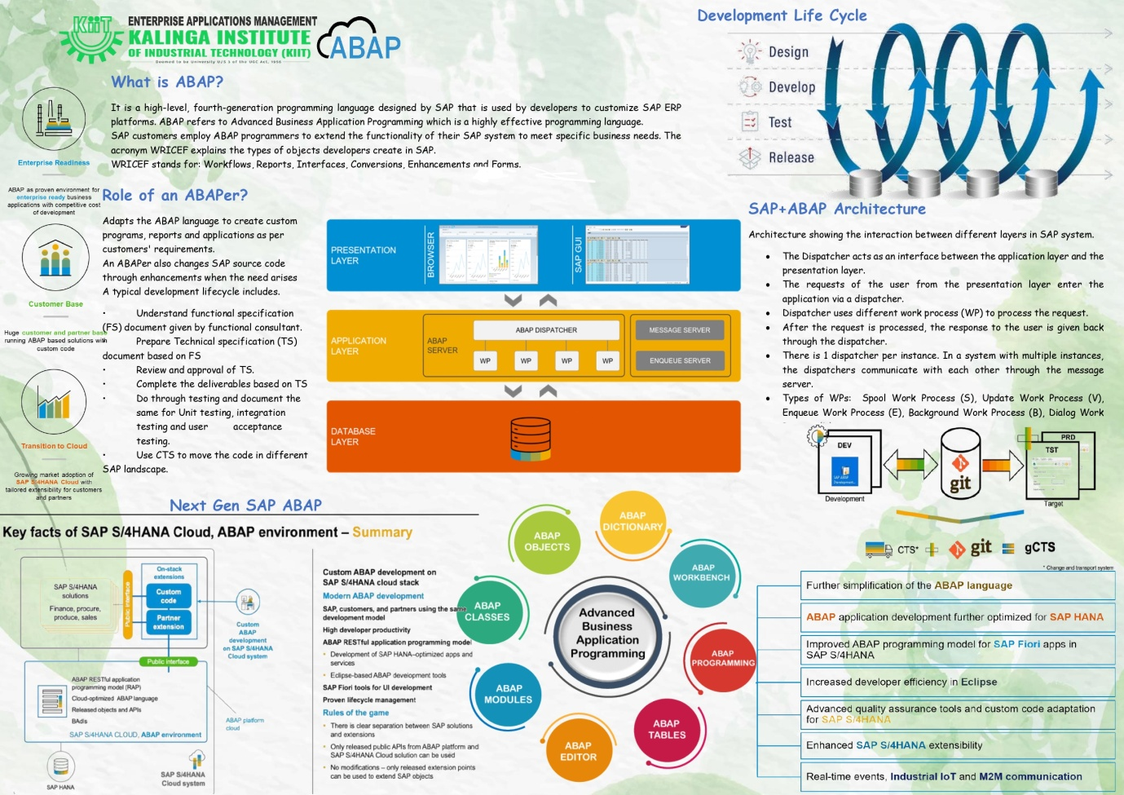
ADVANCED BUSINESS APPLICATION MANAGEMENT (ABAP)
ABAP is the primary programming language supported on the SAP Net Weaver ABAP application server platform and applications that run on it, such as SAP ERP.
The ABAP Workbench is part of the ABAP system and is accessed via SAP GUI.
It contains different tools for editing programs to incorporate new requirements and to maintain existing SAP ERP applications

Slide 15
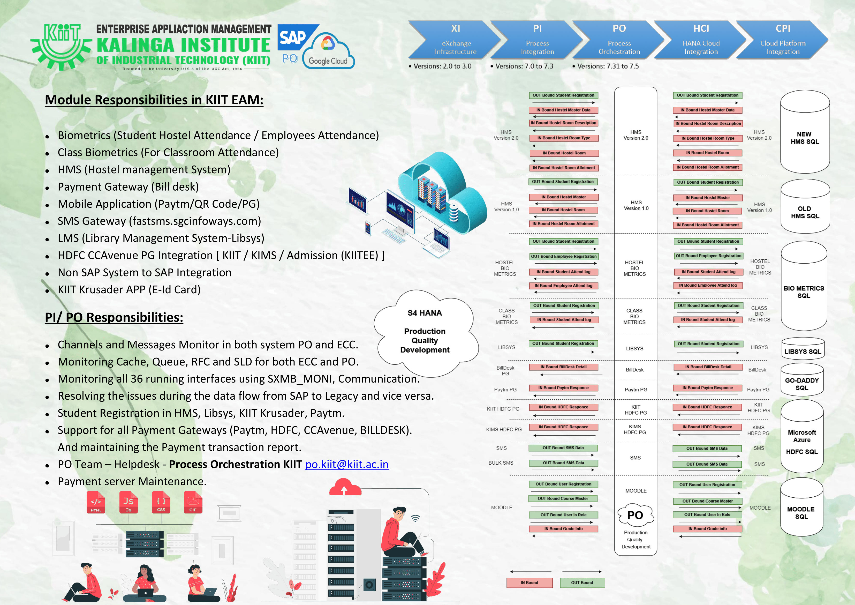
PROCESS ORCHESTRATION (PO)
PO handles online payment transactions through the student’s SAP portal as well as payment options provided on KIIT and KIITEE websitesthrough different payment gateways like HDFC - KIIT / KIMS (Cc Avenue), PAYTM, BILLDESK, etc.
It is for managing and updating student’s data for LIBSYS (Library) and HMS (Hostel Management System) from 3rd parties, Apart from this, PO is also liable for BIOMETRICS Attendance for Students both (Classroom and Hostel) and Employees Attendance.
Additionally, it also provides services for SMS Systems and MOODLE learning systems.

Slide 16
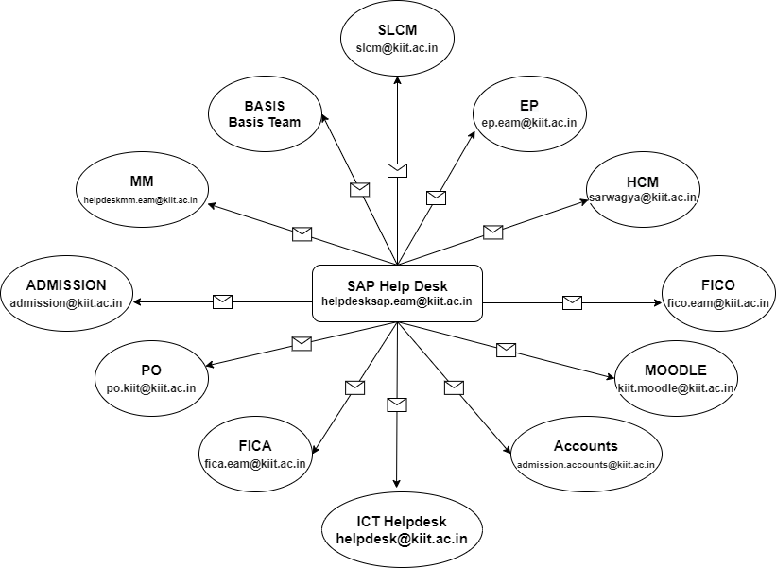
HELP-DESK
The objective of SAP Help-desk is to provide solution for the concerned issues of SAP Users of entire KIIT University (about 30,000 users).
The issues could be related to the following:
Operational
Organizational
Developmental of Data and Securities

Slide 17
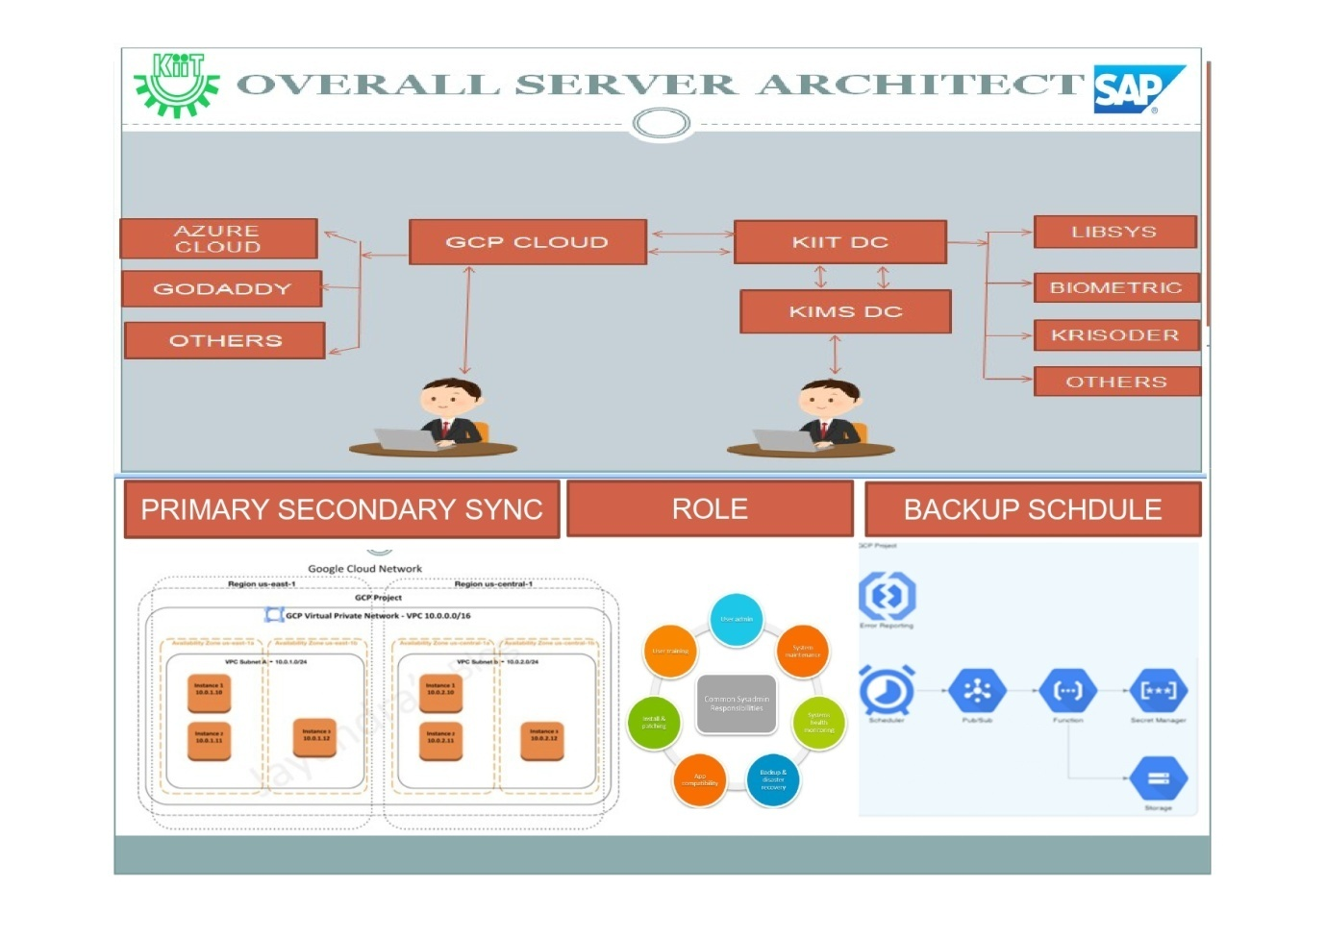
IT & INFRA
The objective of IT & INFRA is to maintain SAP installed servers , monitoring and verifying the backup solutions

Slide 18
THANK YOU

